Slide 1
Computer Graphics
Region Filling and Clipping

Slide 2
Region Filling
There are two basic approaches to area filling on raster systems.
  One way is to draw straight lines between the edges of polygon called scan-line polygon filling(This method is used in fill polygon having simple curves i.e. line, circle etc ).
  Second way is to start from an interior point and paint outward from this point till we reach the boundary called boundary-fill(its used in images having more complex boundaries.).

Slide 3
Region Filling
Polygon
  A polygon can be defined as a shape that is formed by line segments that are placed end to end, creating a continuous closed path.
Rendering
  Generate an image from geometric primitives
  The process of generating an image from a 2D or 3D model (or models in what collectively could be called a scene file) by means of computer programs.

Slide 4
Region Filling
When an unfilled polygon is rendered, only the points on the perimeter(the area immediately inside the boundary) of the polygon are drawn.
However, when a polygon is filled, the interior of the polygon must be considered.
All of the pixels within the boundaries of the polygon must be set to the specified color or pattern.

Slide 5
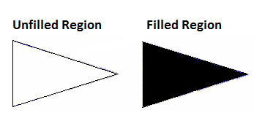
Region Filling

Slide 6
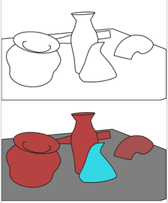
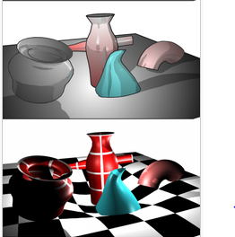
Region filling using Rendering
A scene file contains objects in a strictly defined language or data structure; it would contain geometry, viewpoint, texture, lighting, and shading information as a description of the virtual scene.

Slide 7
Region Filling
Scan-line Polygon Fill algorithm
  Odd-parity rule is used within the scan-line polygon fill algorithm to fill all the pixels that lie inside the polygon.
  Parity
    What is parity? Parity is a concept used to determine which pixels lie within a polygon, i.e. which pixels should be filled for a given polygon.

Slide 8
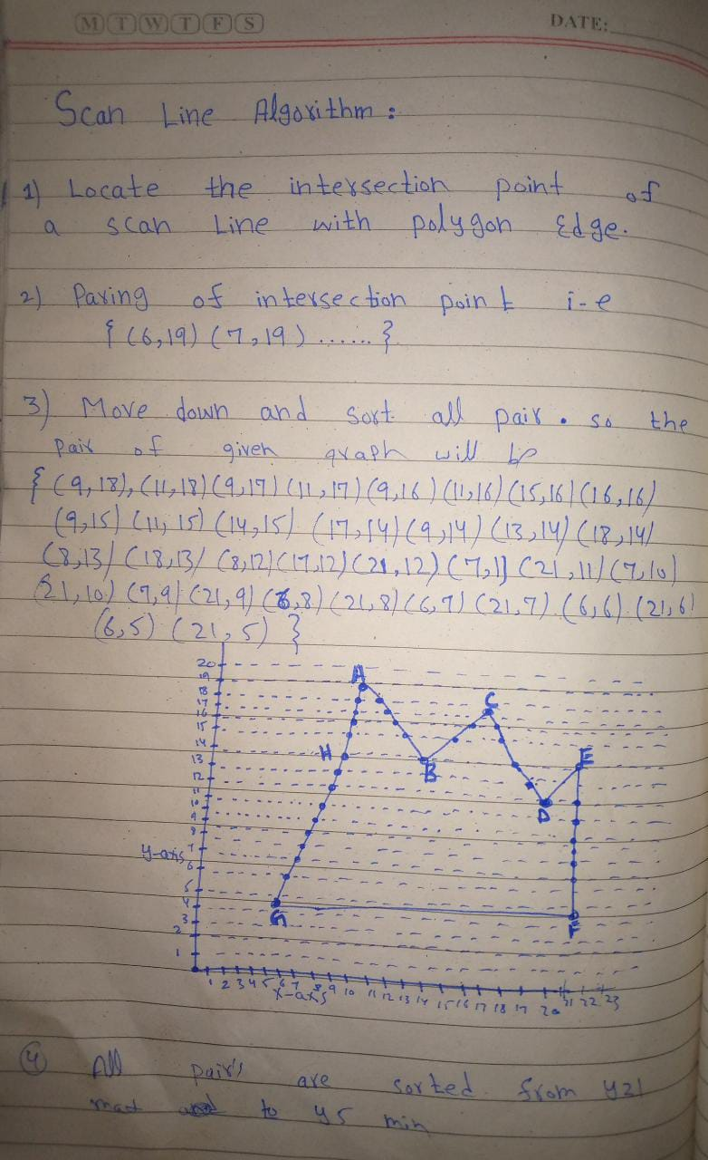

Slide 9
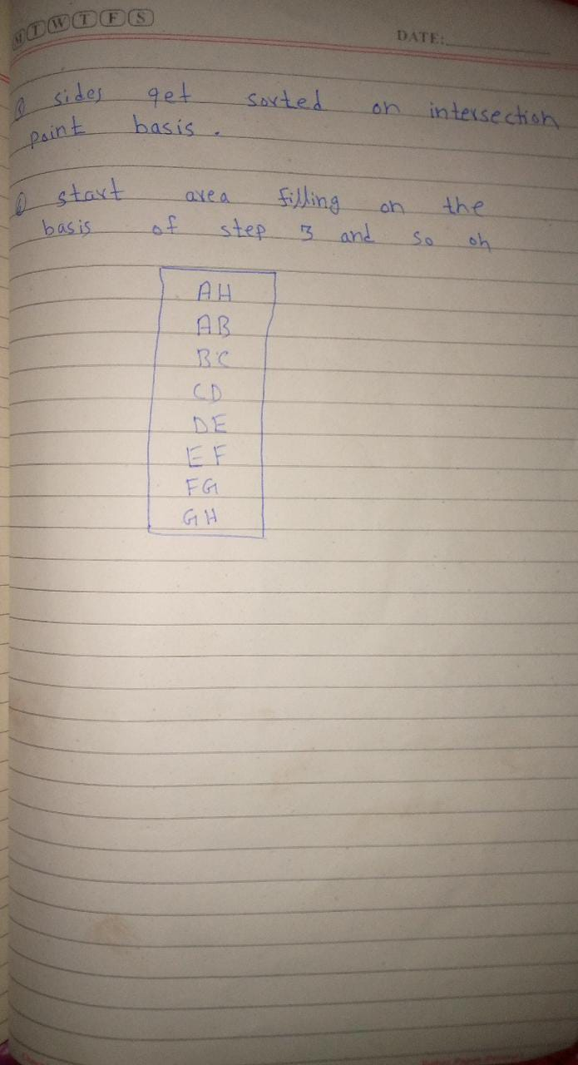

Slide 10
Region Filling
The odd parity test attempt to find all the pixels which are inside polygon and needs to be filled.
Count the number of edges that the line crosses.
  If the number of polygon edges crossed is odd, then P lies within the polygon.
  Similarly, if the number of edges is even, then P lies outside of the polygon.

Slide 11
Region Filling
In odd parity, it would not be very efficient to check each point on our drawing surface to see if it lies within the polygon and, therefore, needs to be colored.
So, we can take advantage of the fact that for each scan-line we begin with even parity

Slide 12
Region Filling
As we go from left to right across our scan line, we will continue to have even parity (i.e., will not use the fill color) until we cross the first polygon edge.
Now our parity has changed to odd and we will start using the fill color.
How long will we continue to use the fill color? Well, our parity won't change until we cross the next edge. Therefore, we want to color all of the pixels from when we crossed the first edge until we cross the next one. Then the parity will become even again.

Slide 13
Clipping

Slide 14
Clipping
Generally, any procedure that identifies those portions of a picture that are either inside or outside of a specified region of space is referred to as a clipping algorithm, or simply clipping.
The region against which an object is to clipped is called a clip window.

Slide 15
Clipping
It is desirable to restrict the effect of graphics primitives to a sub-region of the canvas, to protect other portions of the canvas.
All primitives are clipped to the boundaries of this clipping rectangle; that is, primitives lying outside the clip rectangle are not drawn.

Slide 16
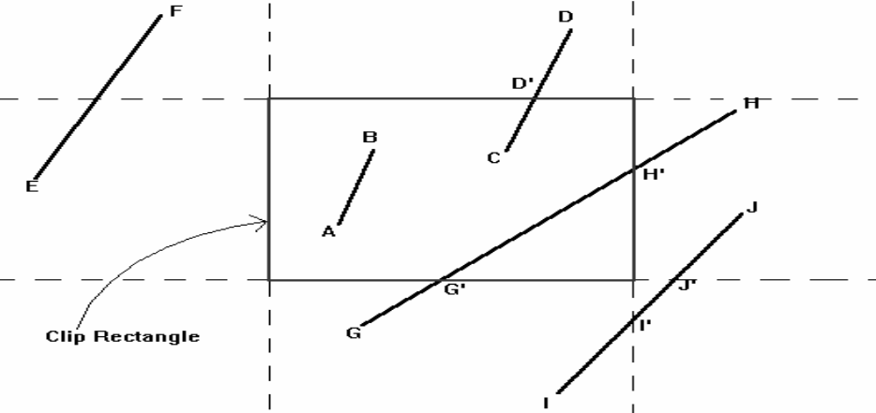
Clipping
The default clipping rectangle is the full canvas (the screen),
It is obvious that we cannot see any graphics primitives outside the screen

Slide 17
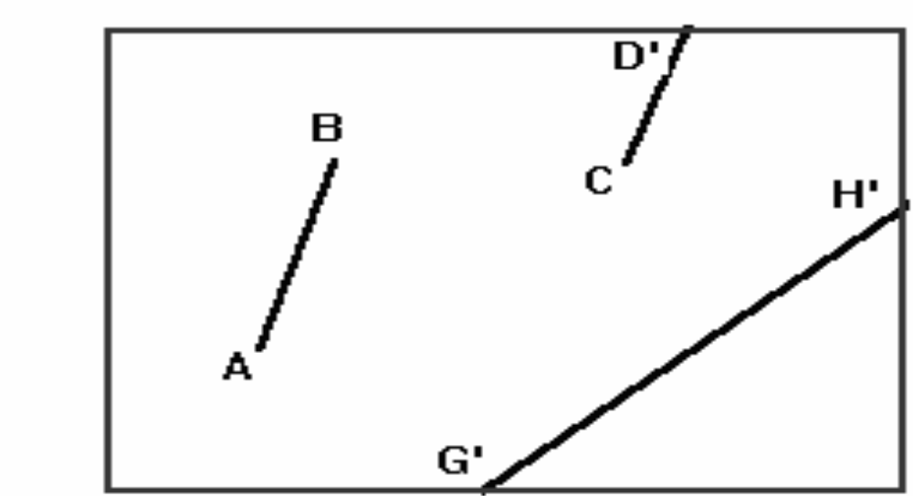
Clipping

Slide 18
Clipping
Point Clipping
Line Clipping (straight-line segments)
Area Clipping (polygons)
Curve Clipping
Text Clipping

Slide 19
Point Clipping
If the x coordinate boundaries of the clipping rectangle are X_{min} and X_{max}, and the y coordinate boundaries are Y_{min} and Y_{max}, then the following inequalities must be satisfied for a point at (X, Y) to be inside the clipping rectangle:
  X_{min} <= X <= X_{max}
    Y_{min} <= Y <= Y_{max}

Slide 20
Line Clipping
A line clipping procedure involves several parts.
  We can test a given line segment to determine whether it lies completely inside the clipping window.
  If it does not, we try to determine whether it lies completely outside the window.
  Finally, if we cannot identify a line as completely inside or completely outside, we must perform intersection calculations with one or more clipping boundaries.
  We process lines through the "inside-outside'' tests by checking the line endpoints.

Slide 21
Polygon Clipping
A polygon is usually defined by a sequence of vertices and edges.
  If the polygons are unfilled, line-clipping techniques are sufficient however,
  if the polygons are filled, the process in more complicated.
A polygon may be fragmented into several polygons in the clipping process, and the original color associated with each one.

Slide 22
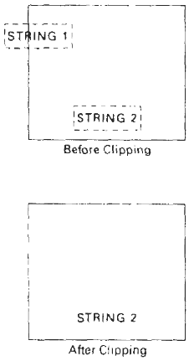
Text Clipping
The simplest method for processing character strings relative to a window
boundary is to use the all-or-none string-clipping strategy.
If all of the string is inside a clip window, we keep it. Otherwise, the string is discarded.

